Slide 1
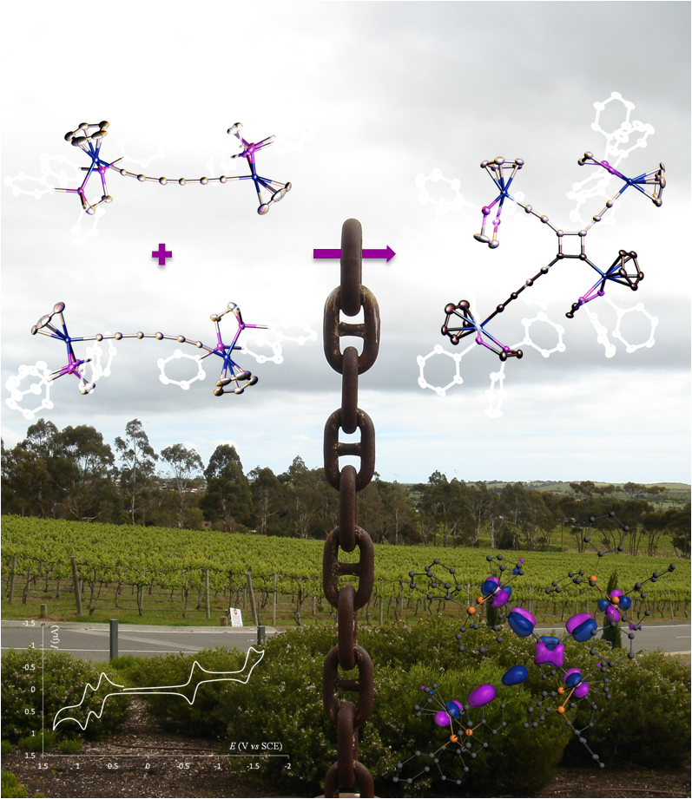
ICCC 2016 Satellite Symposium:
MC2R 2016 : Metal Alkynyl Complexes for Molecular Electronics or Molecular Optics
Registration Form:
• Mr or  Ms
• Name:
• Surname:
•Address:
•Email:
•Mobile Phone:
•Will attend to the MC2R 2016 banquet:
 Yes /  No (Price: 60 €)
Would have her/his (joint) poster considered for an oral communication on the Friday 8th of July morning session (15 mn):
 Yes /  No

